Slide 1
Comparison of higher education systems
And their peculiarities in the US, the UK and Belarus

Slide 2
Entry requirements
Belarus
Britain
US
CT, certificate of General education
A-Levels
SAT scores

Slide 3

TUITION FEE
Belarus
Britain
US
US$ 2 and 2.5 thousand
May also be free
US$ 5-15 thousand per year
US$ 15-35 thousand per year

Slide 4
HOW MANY STUDENTS RECEIVE Grants
Belarus
Britain and the US
75% of students
3-5% of students

Slide 5
Membership in professional associations
Belarus
Britain and the US
Not mandatory
All medical graduates are the members of PA

Slide 6
Traits of the education systems
Eastern
Western
More theoretical, less practical knowledge
Ambition, creativity, independence
The goals of both are same

Slide 7
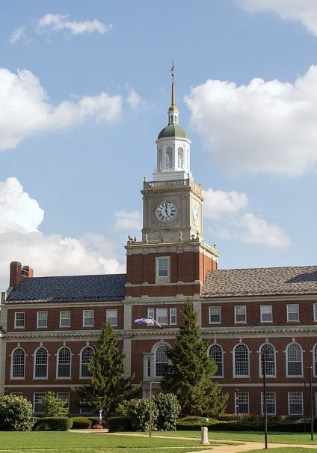
Few facts on USA
More than 4000 universities
15 million students
Both private and public HEIs
Students choose subjects themself

Slide 8
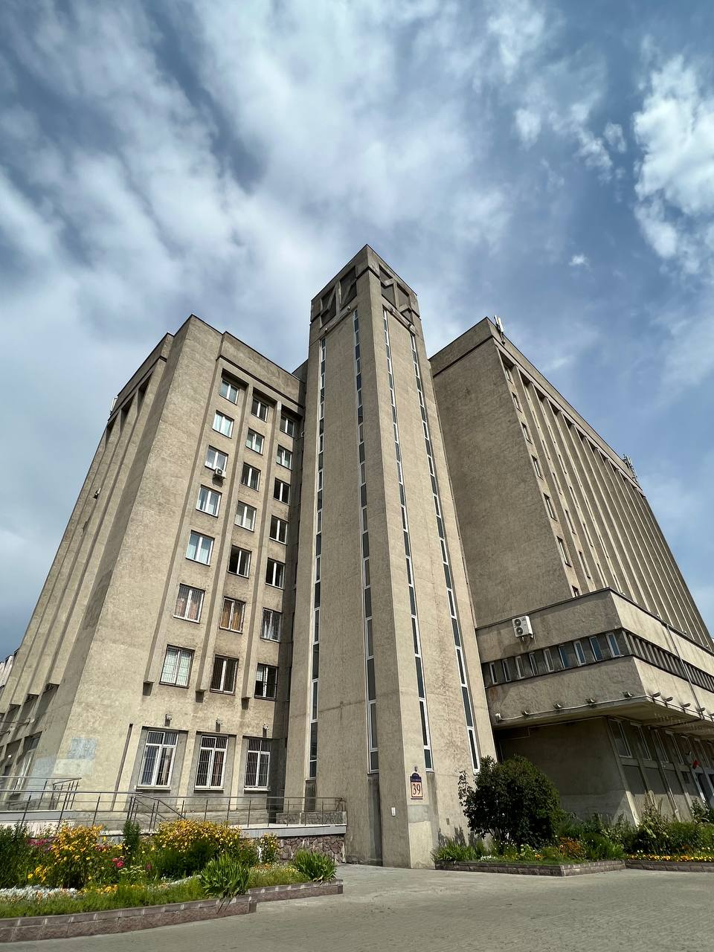
Few facts on BELARUS
More than 240 HEIs
Different forms of studying
4-6 years of study
High quality and availability

Slide 9
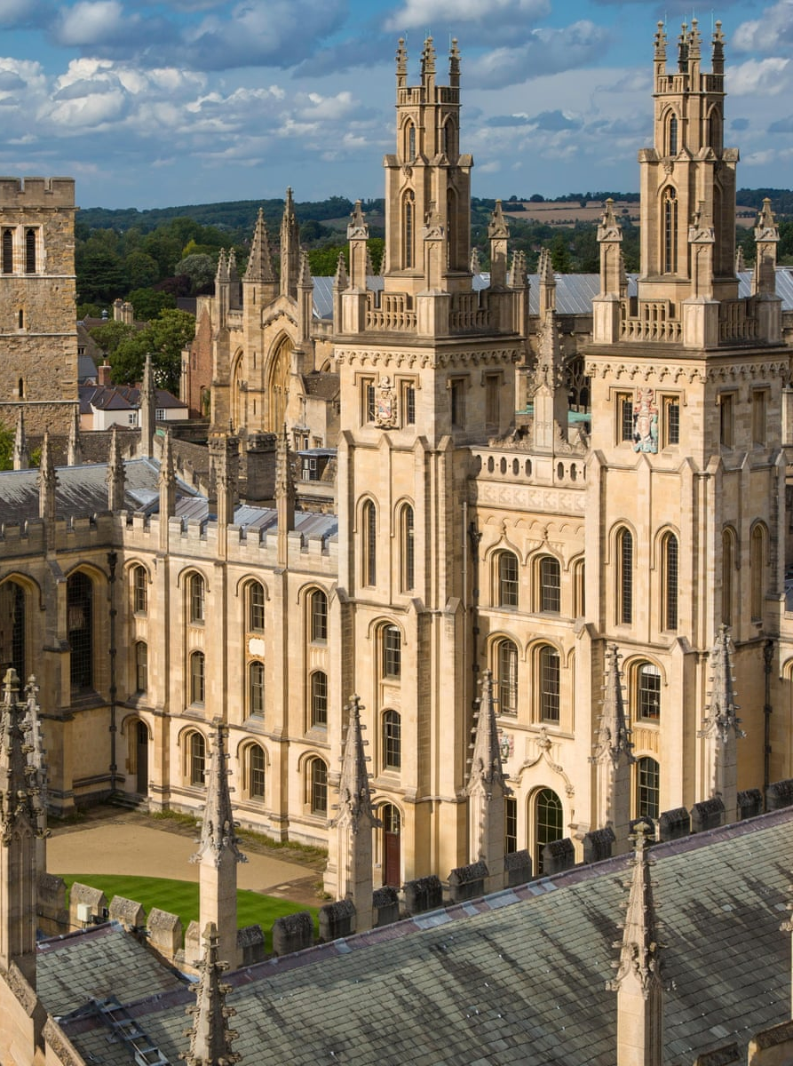
Few facts on THE UK
More than 160 HEIs
Good worldwide reputation
One of top destinations for studying
Funding opportunities for international students

Slide 10
Thanks for attention!

